Slide 1
Pune Vidyarthi Griha's
COLLEGE OF ENGINEERING, TECHNOLOGY & MANAGEMENT, PUNE.
Artificial Intelligence & Data Science
AI-Based Medical Representative Visit Prioritization & Route Optimization System
Bhakti Jayantilal Gundecha (3071) | Parth Lokhande (1020) | Udaykiran Bitla (3056)
Internal Guide: Prof. Mrs. M. U. Buchade
Academic Year 2026-27
1

Slide 2
AI-Based Medical Representative Visit Prioritization & Route Optimization System
Problem Statement
Medical Representatives (MRs) visit multiple doctors daily across a territory. Each doctor has a different priority level, a different availability window, and a different location. Right now, most MRs plan their day using spreadsheets, memory, or fixed routes they have always followed.
This leads to real problems on the ground:
Repeated and overlapping travel that wastes time and fuel
High-priority doctors get the same attention as low-priority ones
Doctor availability windows are tracked informally, leading to missed visits
MRs repeat familiar routes instead of choosing the shortest path
Managers have almost no visibility into what is actually happening in the field
Problem Statement:
"How can AI and optimization techniques be used to automatically prioritize doctor visits and generate an efficient daily visit schedule for a Medical Representative?"
2

Slide 3
AI-Based Medical Representative Visit Prioritization & Route Optimization System
Motivation
Consider a real scenario: one MR, ten doctors, one working day.
Doctor A and Doctor C have high prescription volume (high priority)
Doctor D is only available after 4 PM
Doctor E is 12 km away from the starting location
Doctor F is barely 1 km from Doctor A
Each visit takes 15 to 30 minutes depending on the doctor
A manual plan might handle one or two of these factors. But juggling priority, availability, distance, travel time, and visit duration at the same time? That is where a system is needed.
Our approach combines three things:
AI (Random Forest) for visit prioritization
Appointment constraints for scheduling
Google OR-Tools for route optimization
Published research (Zhang et al. 2014, Yi et al. 2003) confirms pharmaceutical sales-force scheduling is a genuine optimization problem with measurable efficiency gains when automated.
3

Slide 4
AI-Based Medical Representative Visit Prioritization & Route Optimization System
Aim and Objectives
Aim:
To develop an AI-assisted web application that prioritizes Medical Representative doctor visits and generates optimized daily visit routes while considering appointment availability, visit duration, and travel constraints.
Objectives:
Manage doctor profiles, MR information, appointment records, and visit history in a centralized database
Develop a Random Forest model that predicts a visit-priority score for each planned doctor visit
Use Google OR-Tools to solve a Vehicle Routing Problem with Time Windows (VRPTW) and generate an optimized daily visit sequence
Provide role-based dashboards: MRs see their optimized daily plan, managers see team-wide analytics
Evaluate the system using ML metrics (precision, recall, F1), route metrics (distance, time, visits), and application metrics (API speed, usability)
Note: Our AI focuses strictly on visit prioritization and route planning. It does not diagnose patients, predict treatments, or replace the MR's judgment.
4

Slide 5
AI-Based Medical Representative Visit Prioritization & Route Optimization System
Literature Review
Research Paper | Year | Key Point Handled / Proposed | Improvements Suggested
Zhang, Ohlmann & Thomas (European J. of OR) | 2014 | Models a pharma rep's daily visits as a stochastic orienteering problem with time windows. | Strong optimization but no ML-based priority prediction or web dashboard.
Bouatouche & Belkadi | 2025 | Hybrid Firefly + Local Search for sales-rep route planning with coordinates and time windows. | Algorithm/benchmark only. No priority scoring, no end-user application.
Liu, Chen, Por & Ku (Sustainability) | 2023 | Systematic review of 64 VRPTW studies. Most use metaheuristic methods. | General logistics domain. Not adapted for pharma MR constraints.
Ala & Chen | 2022 | Review of 150+ healthcare appointment scheduling papers including AI methods. | Focuses on patient scheduling, not pharmaceutical field-force routing.
Yi, Anandalingam & Sorrell (Expert Systems) | 2003 | Expert system for physician-detailing planning in pharma sales optimization. | Addresses sales effectiveness, not geographic route optimization.
Key gap: existing work isolates ML prediction, routing, or CRM visibility. Nobody integrates all three into one platform.
5

Slide 6
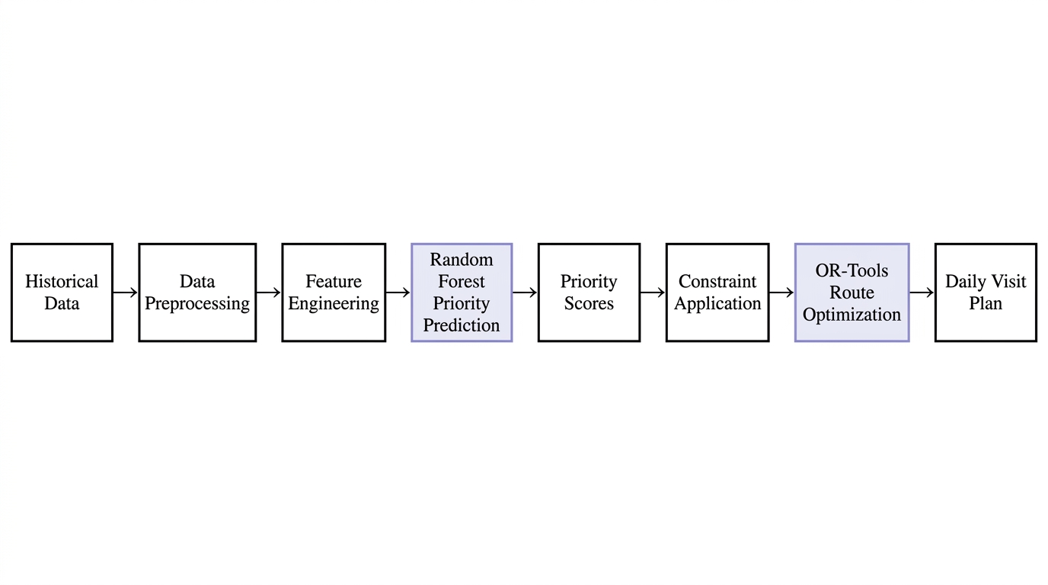
AI-Based Medical Representative Visit Prioritization & Route Optimization System
Abstract / System Overview
Our system takes historical doctor and visit data, predicts which visits matter most using a Random Forest model, then feeds those priorities along with appointment constraints into Google OR-Tools. The optimizer solves a Vehicle Routing Problem with Time Windows and produces an efficient daily route. The MR sees the plan on a dashboard; the manager sees team-wide performance.
Complete Pipeline:
Historical Data > Preprocessing > Feature Engineering > ML Priority Prediction > Priority Scores > Constraint Application > OR-Tools Route Optimization > Daily Visit Plan on Dashboard
How the three layers connect:
Layer | What It Does | Output
Prediction Layer | Random Forest scores each doctor visit based on historical data | Priority score (0 to 1) per doctor
Constraint Layer | Applies doctor time windows, MR working hours, visit durations | Feasible visit set with timing rules
Optimization Layer | Google OR-Tools solves VRPTW for best sequence | Ordered daily route with time slots
6

Slide 7
AI-Based Medical Representative Visit Prioritization & Route Optimization System
Requirements, Test Environment and Tools
Hardware Requirements:
Software Stack:
Processor: Intel i5 or equivalent
RAM: 8 GB minimum, 16 GB preferred
Storage: SSD with 50 GB+ free space
Internet connectivity for API access
Category | Technology
Language | Python 3.x
Frontend | React.js
Backend | FastAPI
Database | MySQL
ML | Scikit-learn
Data Processing | Pandas, NumPy
Optimization | Google OR-Tools
Version Control | Git / GitHub
IDE | Visual Studio Code
Deployment:
Web-based application. Cloud deployment planned after integration testing is complete.
7

Slide 8
AI-Based Medical Representative Visit Prioritization & Route Optimization System
Proposed System
How the system works, step by step:
Step 1: Collect historical data (doctor profiles, visit history, appointments) and store in MySQL.
Step 2: Preprocess data: clean missing values, encode categories, normalize numerical features.
Step 3: Engineer features: days since last visit, visit frequency, specialty, prescription volume.
Step 4: Train a Random Forest model that predicts a priority score (0 to 1) per doctor visit.
Step 5: Apply constraints: Doctor A only available 10 AM to 12 PM, MR works 9 AM to 6 PM, each visit takes 20 min.
Step 6: Feed priorities and constraints to Google OR-Tools. The solver produces an optimized visit sequence.
Step 7: Display the optimized plan on the MR dashboard. Manager sees team-wide schedules and analytics.
The ML model and the optimizer are two separate components. The model scores the visits; the optimizer sequences them. They can be evaluated independently.
8

Slide 9
AI-Based Medical Representative Visit Prioritization & Route Optimization System
Proposed Outcome
We will evaluate the system at three levels:
ML Evaluation:
Route Evaluation:
System Evaluation:
Accuracy
Precision
Recall
F1-Score
Confusion matrix
Total travel distance (km)
Total travel time
Visits completed per day
Late arrivals
Waiting time
% improvement over baseline
API response time
Dashboard load time
Role-based access control
Data validation
Important: these are our evaluation criteria and planning targets. The values shown are not achieved results. We will only report actual numbers after implementation and testing. The baseline for route comparison will be a nearest-neighbour heuristic and a simulated manual planning approach.
9

Slide 10
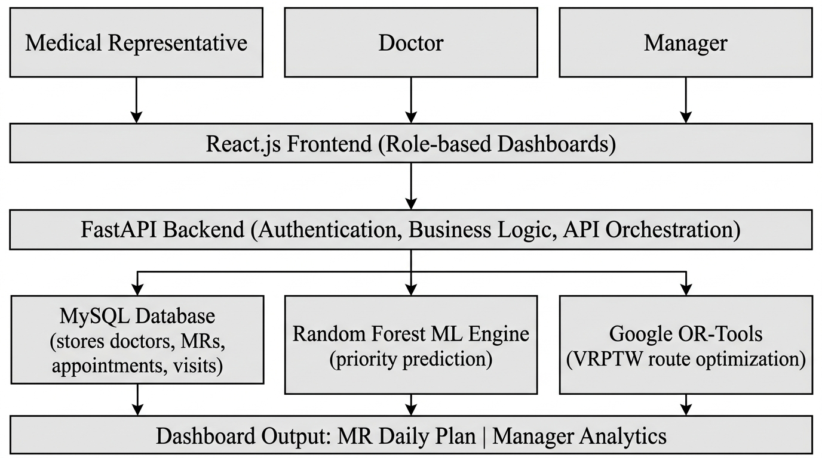
AI-Based Medical Representative Visit Prioritization & Route Optimization System
Architecture
Layered System Architecture:
Users: Medical Representative, Doctor, Manager
|
v
React.js Frontend (role-based dashboards for MR, Doctor, Manager)
| REST APIs
v
FastAPI Backend (authentication, business logic, model orchestration)
|
v
Three backend services:
MySQL Database | Random Forest Engine | Google OR-Tools
Doctors, MRs, appointments, visit history | Predicts visit-priority score per doctor | VRPTW route optimization with constraints
Key point: the ML model and OR-Tools are separate modules. The model scores visits, the optimizer sequences them. Either can be improved or replaced without affecting the other.
10

Slide 11
AI-Based Medical Representative Visit Prioritization & Route Optimization System
References
[1] J. C. Yi, G. Anandalingam, and L. A. Sorrell, "An expert system to physician-detailing planning," Expert Systems with Applications, vol. 25, no. 4, pp. 533-544, 2003.
[2] S. Zhang, J. W. Ohlmann, and B. W. Thomas, "A priori orienteering with time windows and stochastic wait times at customers," European J. of OR, vol. 239, no. 1, pp. 70-79, 2014.
[3] A. Bouatouche and A. Belkadi, "A hybrid firefly algorithm for the sales representative planning problem," 2025.
[4] X. Liu et al., "A Systematic Literature Review of Vehicle Routing Problems with Time Windows," Sustainability, vol. 15, no. 15, 2023.
[5] A. Ala and F. Chen, "Appointment Scheduling Problem in Complexity Systems of the Healthcare Services," 2022.
[6] Google OR-Tools Documentation, "Vehicle Routing Problem with Time Windows (VRPTW)."
Complete bibliographic details with DOIs will be provided in the final project report.
11

Slide 12
AI-Based Medical Representative Visit Prioritization & Route Optimization System
Project Plan 1.0
Phase | Duration | Work
Research | Weeks 1-2 | Literature survey, problem finalization, requirement analysis
Dataset | Weeks 3-4 | Dataset identification, acquisition, cleaning, preprocessing
ML Model | Weeks 5-7 | Feature engineering, Random Forest training and evaluation
Optimization | Weeks 8-9 | VRPTW formulation, Google OR-Tools implementation
Backend | Weeks 10-11 | FastAPI REST endpoints, MySQL database design, authentication
Frontend | Weeks 12-13 | React.js UI, MR dashboard, Manager dashboard
Integration | Weeks 14-15 | Connect ML + optimizer + backend + frontend end-to-end
Testing | Weeks 16-17 | System testing, performance evaluation, documentation
This is Project Plan 1.0. We will refine the timeline based on feedback from this review.
12

Slide 13
Thank You
Questions & Suggestions Welcome
Bhakti Jayantilal Gundecha | Parth Lokhande | Udaykiran Bitla
Guide: Prof. Mrs. M. U. Buchade | Group 19 | Dept. of AI & DS
13

